Slide 1
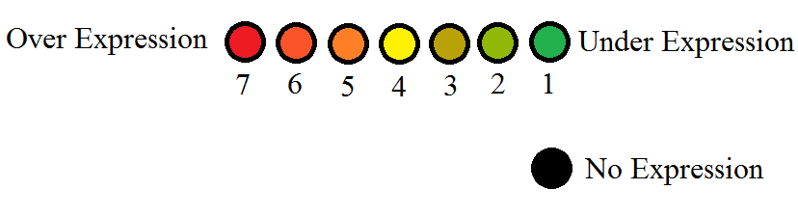
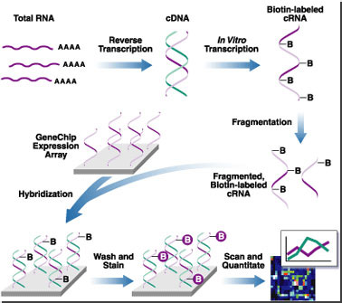
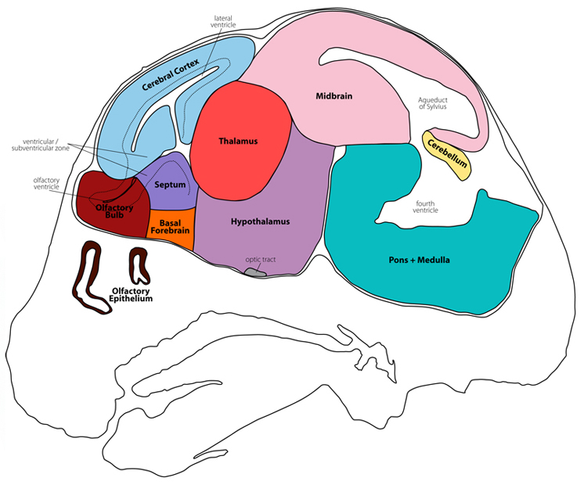

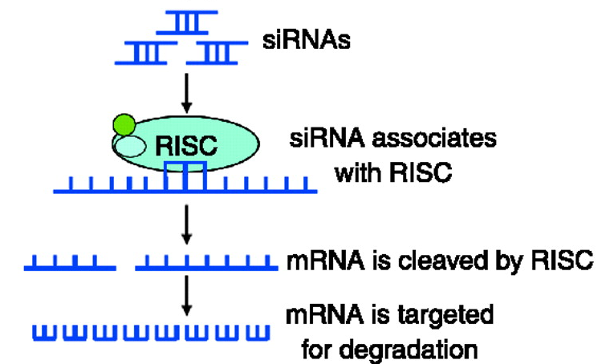
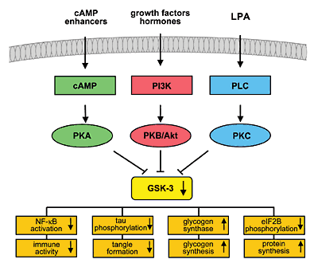
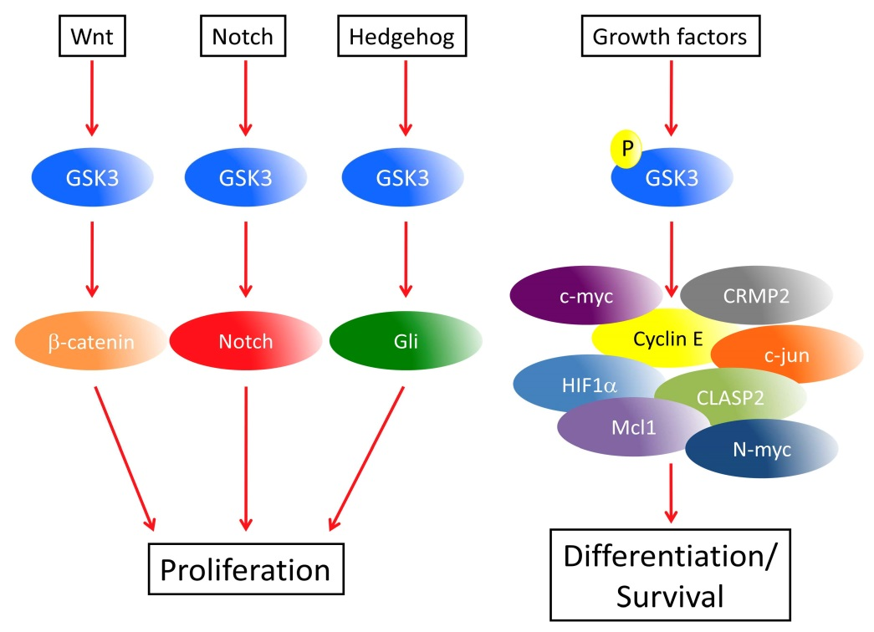
Mice Cutting Their Genes
A study on the Developmental Impact of siRNA against GSK3 in Mice
Abstract
Mice were given siRNA against GSK3 side by side with untreated mice by a collaborating lab. The cerebellums were received and the RNA was isolated. A microarray was prepared using the untreated mice as control data and the siRNA treated mice as experimental data. This allows visualization the differences in gene transcription between the two groups of mice. Green spots on the microarray signify a down regulation of normal cerebellum genes in siRNA mice, while red spots signify an up regulation of the genes in the siRNA mice. The more red the spot is, the more likely that the gene is typically not transcribed. Yellow and black spots represent normal gene regulation. Results suggest that overall there is a down regulation of many genes in the treated mice’s cerebellum.
Melissa Moyer
K. Joy Karnas, Ph.D. Associate Professor and Director of Genetic Engineering Cedar Crest College, Department of Biological Sciences
100 College Drive, Allentown, PA 18104 610-606-4666 x36814
Materials and Methods
Microarrays and mRNA prep:
Microarrays and mRNA preparation were done using standard procedures for reverse transcription and microarray slide preparation as outlined in the figure below.
The microarrays were analyzed using a program called ScanAlyze, and then compiled in Excel.
Results
Table 1: Count of flag labels, for a total of 236 spots labeled out
of 37632 total spots.
Figure 4: Flag numbers, Expression level, and Microarray spot colors guide. Those with no expression have a flag number of zero, while the other spot colors have a flag number underneath. Over expression versus under expression refer to the experimental versus the control.
http://angerer.swissbrain.org/archive/2002/11/
Figure 6: Microarray Procedures
Table 2: A sample of genes that were positive in expression ranging in flag number seven to one. The columns labeled SPOT, GRID, ROW, and COL give the location of the expressed genes which we flagged. The ID allows us to determine the type of RNA that was found in the Cerebellum. ID2 is a generalization of the ID so that it is easier to understand.
Introduction
We received treated mouse cerebellum from the lab of Amanda Myers and Eleonore Beurel at the University of Miami, our collaborating lab. GSK3 has been linked to many diseases such as Multiple Sclerosis, mood disorders, Alzheimer’s disease, diabetes, cancer, among. siRNA is used to block the translation of specific messages into their corresponding proteins. The siRNA chosen was specific to the GSK3 gene, allowing a complete knock out of GSK3.
Figure 5: Experimental Grid 10
The siRNA against GSK3 has generally reduced transcription levels of many control mice genes. It also raised transcription levels of a few genes. These results are consistent with some of the general pathways shown in Figures 2 and 3. However, at least one of the spots that should’ve been negative came up positive in the treated mice. This is most likely due to background fluorescence on the slide (Figure 5). More data is needed to accurately distinguish the difference between a background spot and a positive result.
http://www.gensat.org/imagenavigator.jsp?imageID=35762
Figure 7: Labeled mouse brain diagram. We only used the cerebellum, labeled in yellow.
Figure 1: siRNA breaks down mRNA to block translation of proteins.
Discussion
Jope et al. found GSK3 causes irritation and swelling in many diseases. The hope is that by knocking out GSK3 we can stop the progression of many of the diseases, or at least reduce the symptoms.
So far, there does not seem to be many problems created by a GSK3 knockout in the cerebellum. Further research is required to determine if a GSK3 knockout is safe and effective for treatments.
http://www.reproduction-online.org/content/137/6/901/F5.large.jpg
Animal Testing
Using animals for testing different treatments has long been controversial. Many people feel that it is cruel to use them; however, without this testing we would not have the amount of knowledge that we do on many conditions present in the world today, nor would we know how to treat most of them. There are strict guidelines as to the use of animals. They are sacrificed humanly so little to no pain is felt by the subject. It is not right to use animals frivolously for testing, there must be a good reason behind their use that will further society's knowledge.
References
Jope, Richard S., Christopher J. Yuskaitis, and Eléonore Beurel. "Glycogen Synthase Kinase-3 (GSK3): Inflammation, Diseases, and Therapeutics." Neurochemical Research 32.4-5 (2007): 577-95. Print.
http://www.ncbi.nlm.nih.gov
Meebo Batch 8 Excel
Amanda Myers and Eleonore Beurel at the University of Miami
http://journals.prous.com/journals/dnp/20031609/html/dn160557/images/VanWayme_f1.gif
http://www.intechopen.com/source/html/43840/media/image1_w.jpg
Figures 2 and 3: A few pathways with GSK3 regulation and corresponding effects.

